Slide 1

SMART GROCERY
E-COMMERCE SYSTEM
27 May, 2025

Slide 2
HELLO!
Presented by:
EMAZ ALI KHAN (65566)
ABDUL RAFAY ZAHID (65540)
SUMAIKA ASIF (65651)
Presented To:
PROF. MAQSOOD RAZI

Slide 3
AGENDA OVERVIEW
01
05
INTRODUCTION
ACTORS AND USE CASES
02
06
PROBLEM STATEMENT
PROJECT OUTPUT (FEATURES)
03
07
OBJECTIVE
CONCLUSION & FUTURE SCOPE
04
08
CURRENT AND PROPOSED SYSTEM
QUESTION & ANSWER

Slide 4

INTRODUCTION
SmartGrocery is an online platform that makes grocery shopping easy and convenient. It allows customers to browse products, place orders, and choose payment options. Admins manage inventory and orders, while drivers handle deliveries. The system aims to modernize grocery shopping by providing a smooth and efficient experience for all users.

Slide 5
PROBLEM STATEMENT
Our study focuses on developing an integrated online grocery system to address challenges in ordering, inventory management, and delivery faced by traditional grocery stores.
01
02
03
SCOPE OF THE STUDY
RELEVANCE OF THE STUDY
RESEARCH QUESTION
This project focuses on creating an online platform for grocery ordering, inventory control, and delivery management for small to medium stores.
The study addresses growing customer demand for convenient online shopping and real-time order tracking, especially post-pandemic.
How can an integrated online grocery system improve customer convenience, inventory accuracy, and delivery efficiency?

Slide 6
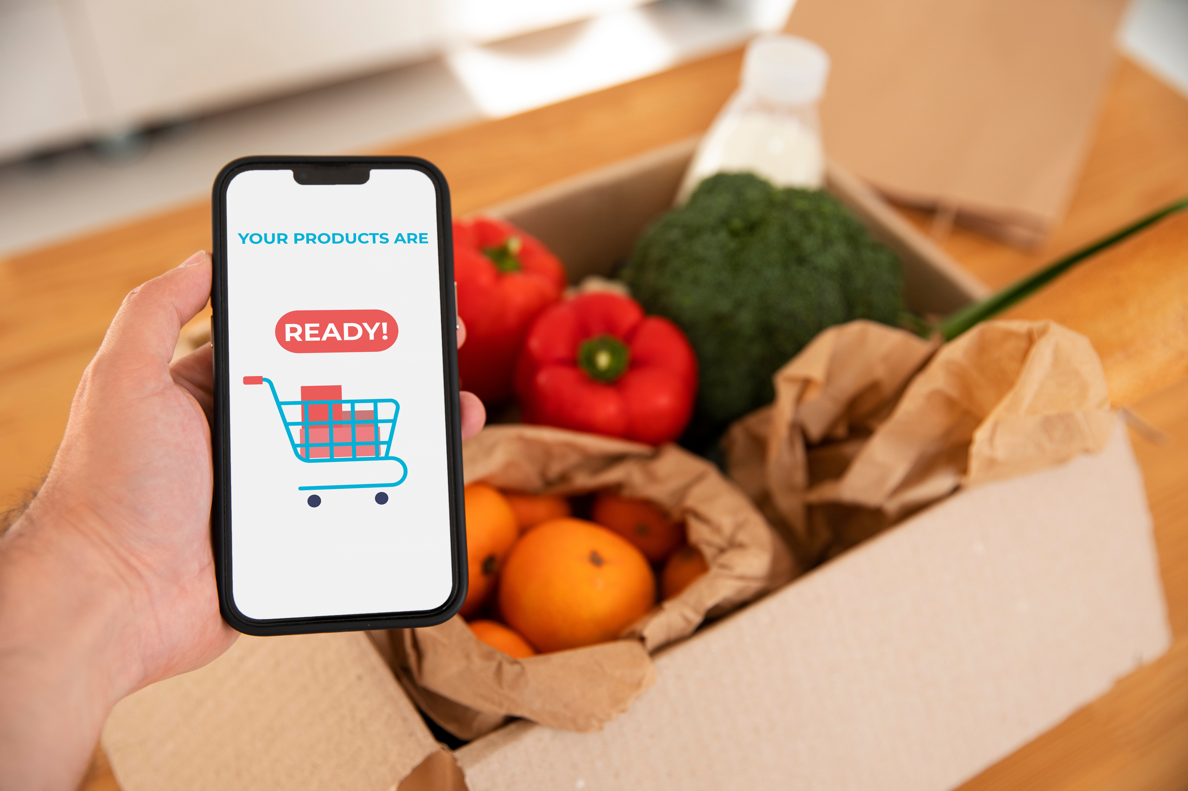
OBJECTIVE
The objective of this project is to design and develop an efficient online grocery shopping platform that enables users to browse and order products easily, allows admins to manage inventory effectively, and supports drivers in delivering orders promptly. The system aims to enhance user convenience, improve operational efficiency, and provide real-time order tracking and payment options.

Slide 7
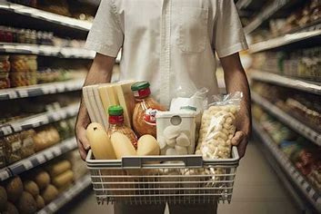
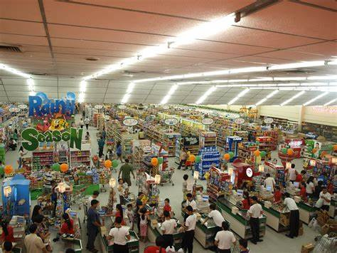
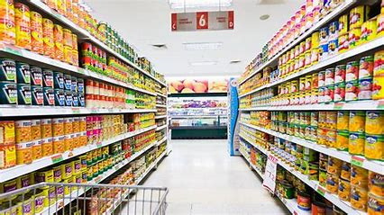
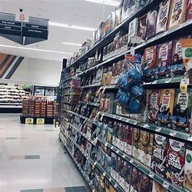
CURRENT
SYSTEM

Slide 8
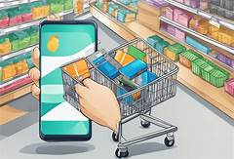
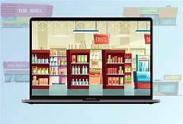
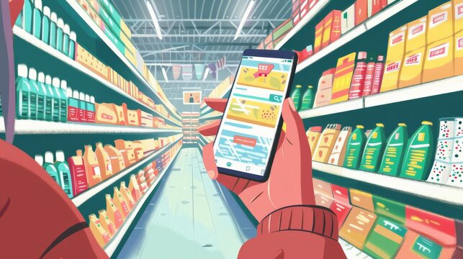
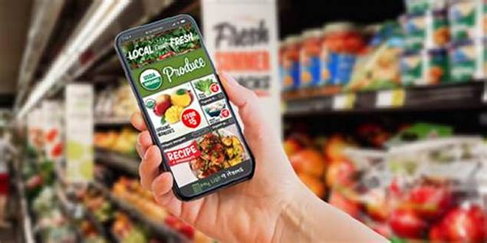

PROPOSED
SYSTEM

Slide 9
ACTORS & USE CASES
USER
ADMIN
DRIVER
1. Register
2. Login
3. Add Product to Cart
4. Remove Product from Cart
5. View Cart
6. Place Order (Only if total > 2000)
7. Choose Payment Method
8. Receive Driver Details after Order
9. View Order History
1. Login
2. Add Product
3. Update Product
4. Delete Product
5. View All Orders
6. Monitor Inventory (Low Stock Alerts)
7. View Best-Selling Products
8. Validate Data
9. Assign Drivers
1. Login
2. View Assigned Orders
3. View User Details
4. Check Payment Status
5. Mark Payment Received (if COD)

Slide 10
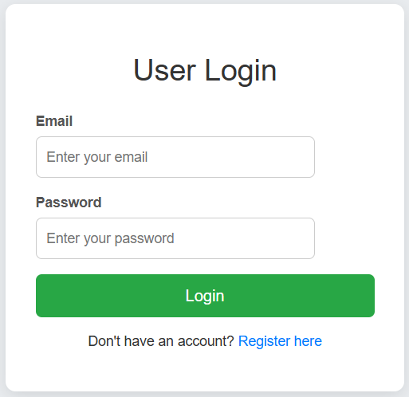
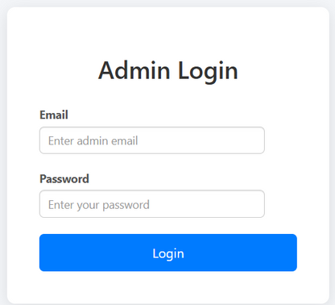
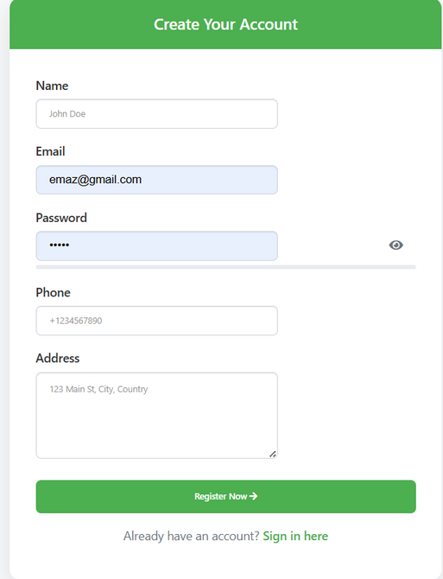
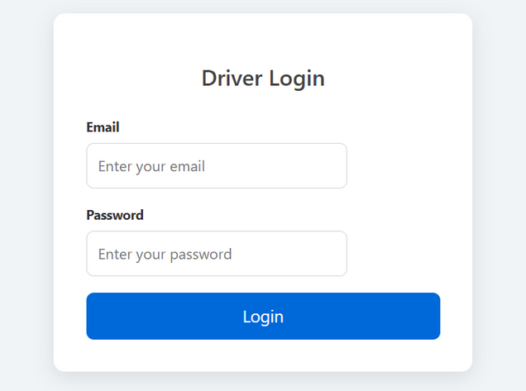
PROJECT OUTPUT (FEATURES)

Slide 11
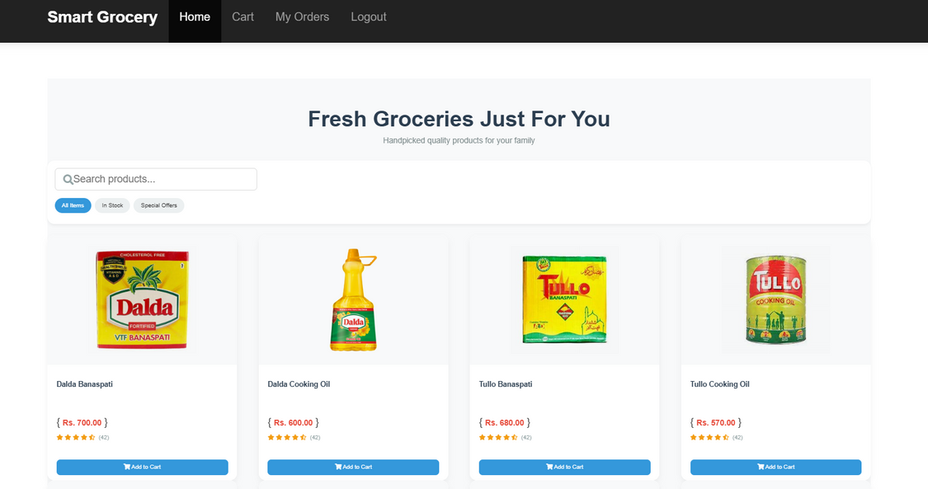
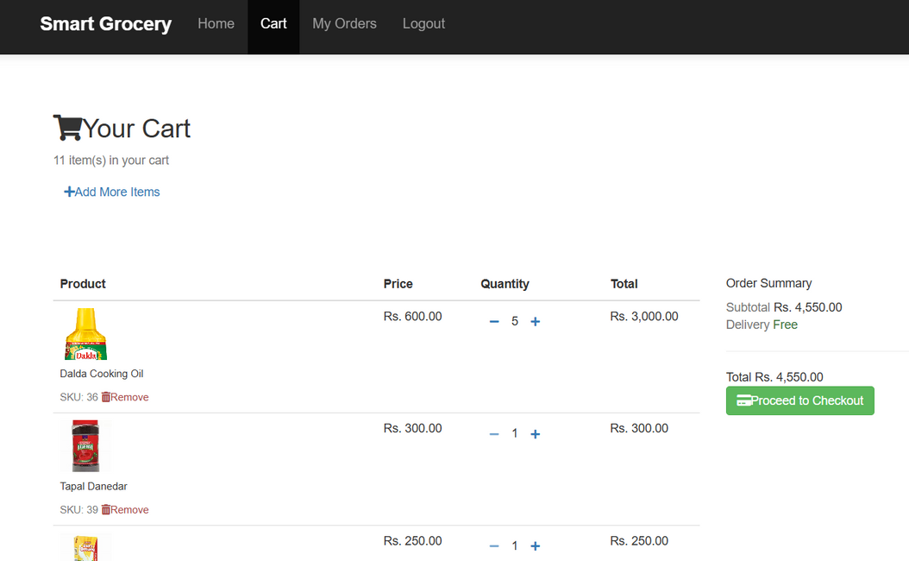
PROJECT OUTPUT (FEATURES)

Slide 12
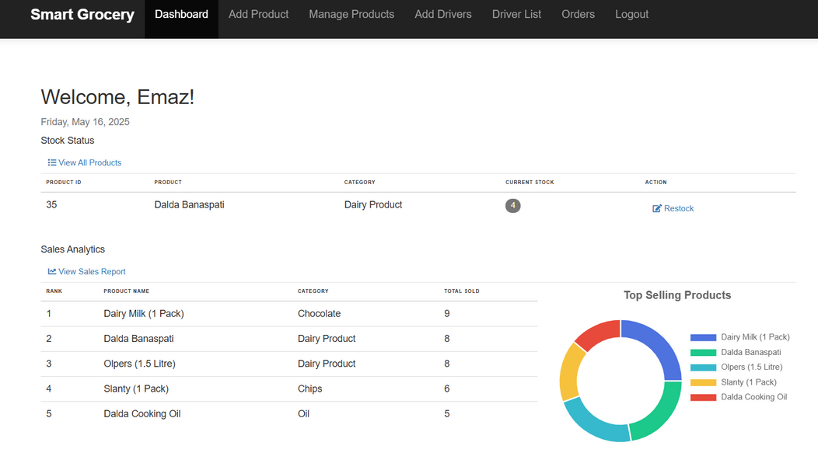
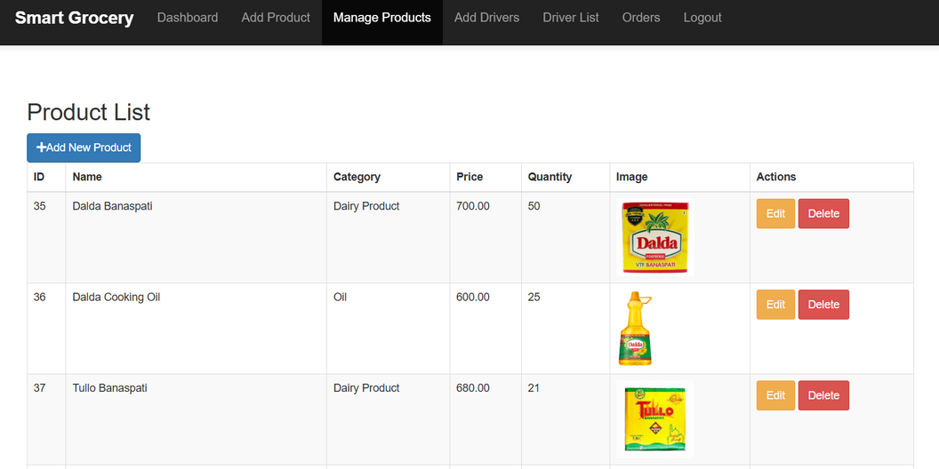
PROJECT OUTPUT (FEATURES)

Slide 13
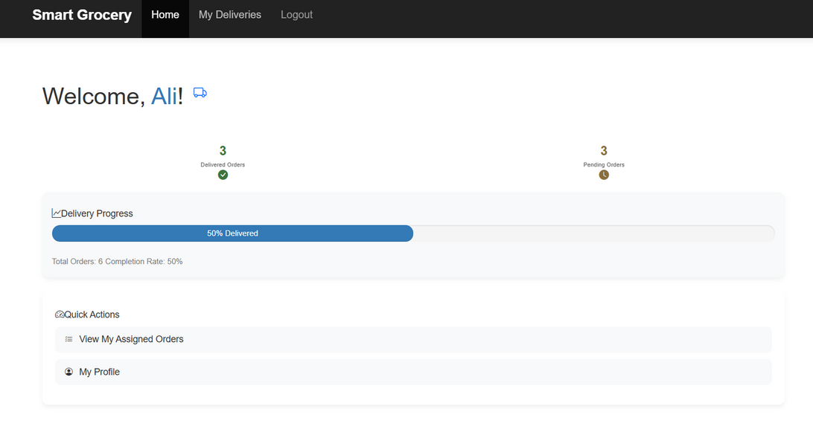
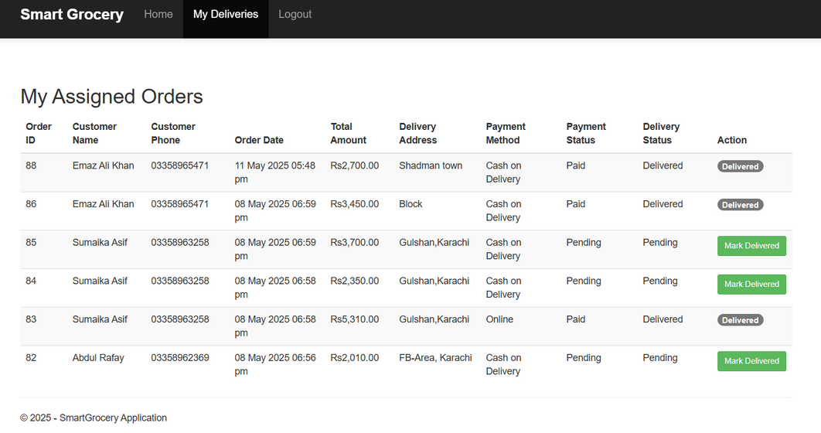
PROJECT OUTPUT (FEATURES)

Slide 14

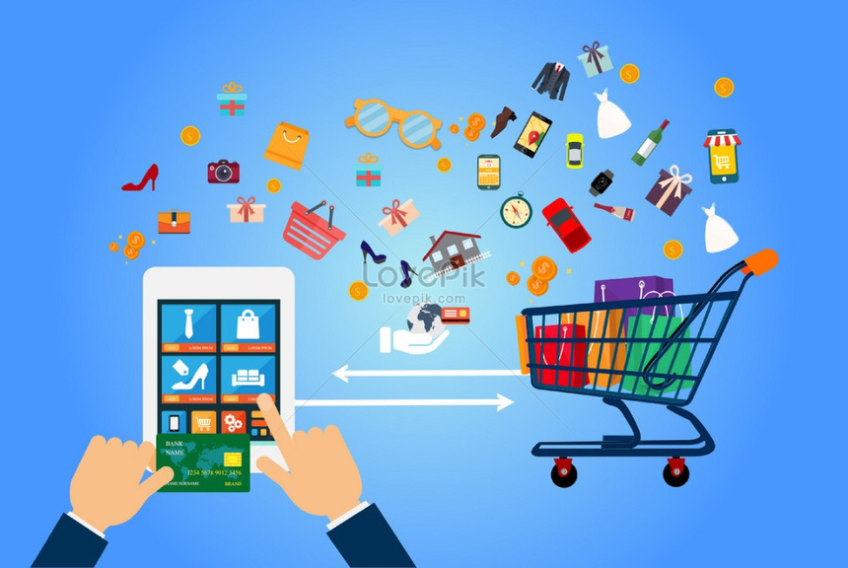
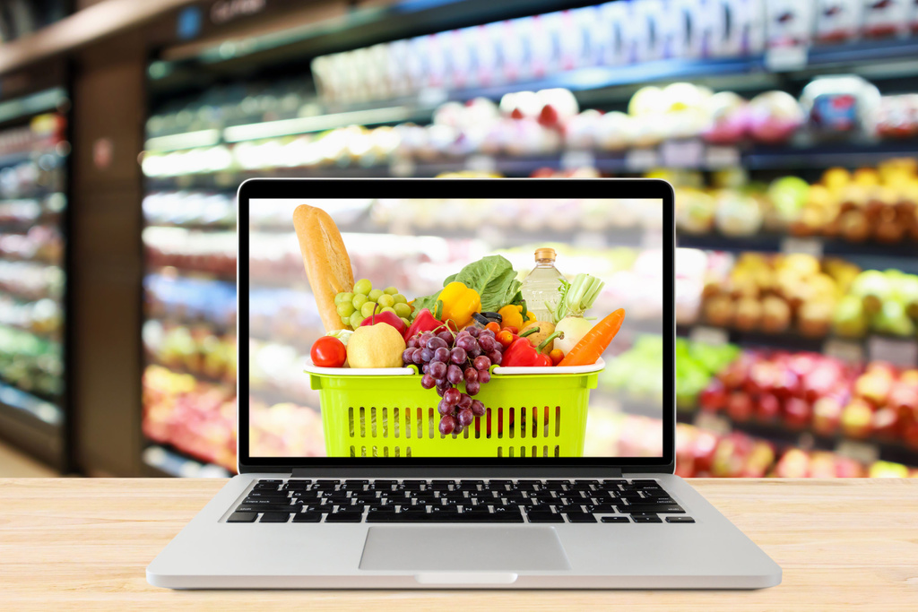
CONCLUSION
SmartGrocery provides a simple, efficient platform for online grocery shopping, improving user convenience, admin control, and delivery handling.
FUTURE SCOPE
Add mobile app support
Expand to multiple stores
Integrate real-time delivery tracking
Use AI for product suggestions

Slide 15
QUESTION
&
ANSWER

